Slide 1
Market Development
PI-20 Guide

Slide 2


Tanzania Instant Payment System
The Platform: Tanzania Instant Payment System (TIPS)
The Actors: BOT, EGA, MOF
Use Cases: The platform will include use cases such as P2P, P2B, Tax and Bulk Payments
Milestones: The pilot began towards the end of 2021 and included a closed user group of 3 Banks and 2 MNOs
GTM Objectives:
Successful platform that we can talk about publicly
Bring TIPS team to be more active in the community
Have a place to bring potential adopters
Opportunities
Market field day in Zanzibar convening
NPCI / PISP integration
Rwanda learnings
Progress
Field Trip in Zanzibar
Participation in next convening
Mojaloop Members
Status as of Q1 2022: The first phase is expected to begin in Q1 of 2022 and will include use cases such as person- to- person and person-to-business payments and the later stages will include tax and bulk payments

Slide 3
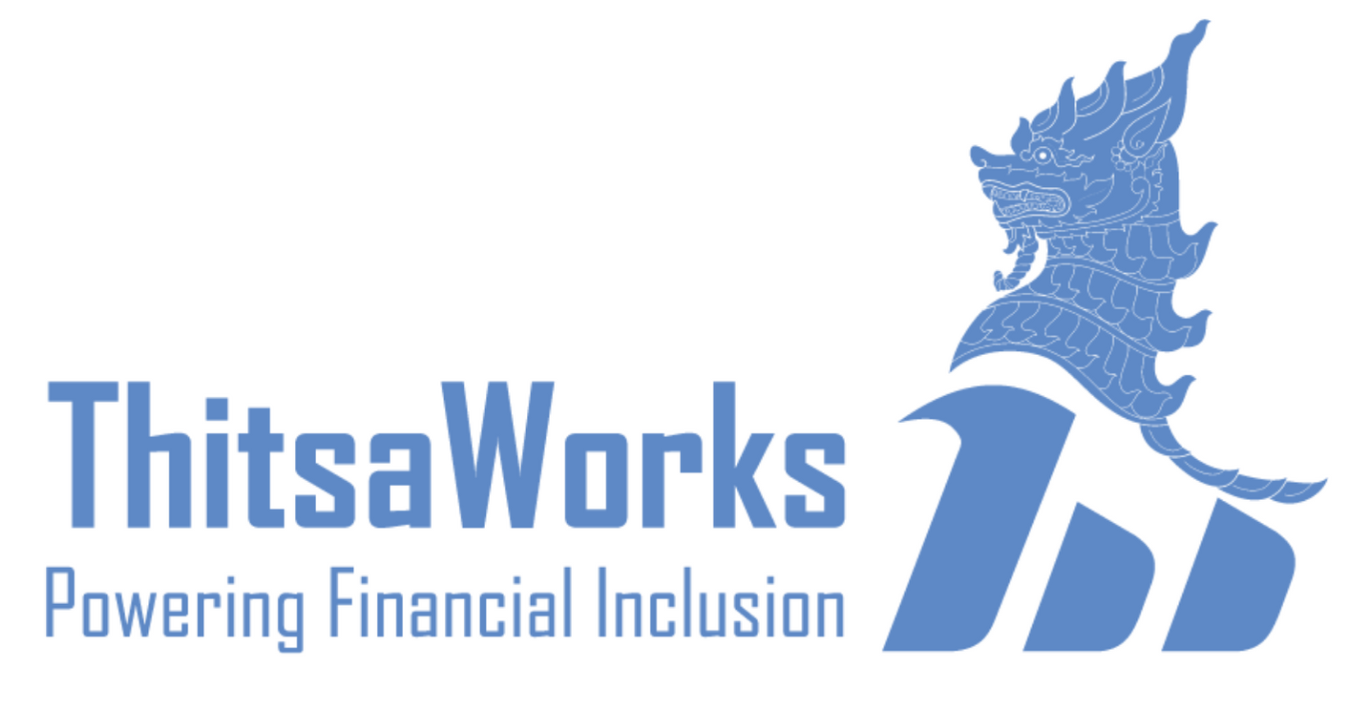



Myanmar Microfinance Digitization / WynePay
The Platform: MMD / WynePay – subnational system
The Actors: Thitsaworks, UNCDF, MMFA, ModusBox, CB Bank.
Use cases: Loan repayment, Loan disbursement, ECT
Milestones: Wynepay has completed functional testing trials in March 22 and is onboarding about 30 DFSPs for a close user group testing in April 2022
GTM Objectives:
Market readiness and validation of PISP and cross border
Expand to Myanmar national system (when politically feasible)
Opportunities
MAS POC - Bringing Visa into the community
NPCI / PISP POC
Philippines expansion at crucial moment
Regional hub opportunity
Assist CBDC COE with acceleration
Progress
Growing beyond existing scope
Expanding to cross border (more later)
More wallets joining
CBM considering Mojaloop
Thitsaworks going to PISP Bootcamp
ILF grant recipient
Mojaloop Members
Status as of Q3 2022:Waiting on CBM approval for go live. Expected imminently. Expanding to cross border use case.

Slide 4

Rwanda National Digital Payment System 2.0
The Platform: Rwanda National Digital Payment System (R-NDPS 2.0) is the next phase of their blueprint
The Actors: RISA, Rswitch, Africa Nenda, Modusbox, Google, Jigsaw, GIZ
Use cases: RSwitch has prioritized P2P, P2G, P2B, and B2P use cases
Milestones: Merchant payments and PISP primarily
GTM Objectives:
Grow number of African implementers
Launch to EAC
Demonstrate locally built national project plan and roadmap
Opportunities
Bring GIZ into other deployments and community
Progress
Aligning with RISA objectives
Working with 4 System Integrators who have all agreed to come to Zanzibar and try to contribute to Mojaloop code in various ways
Linking DIAL CMU open source project to CMU-Kigali
Mojaloop Members
Status as of Q3 2022: RSwitch is focusing on adjustment required by BNR for first switch, causing delays
Risk: Inaction causes Rwandan and international stakeholders to lose interest and de-invest
Notes:
https://www.bnr.rw/browse-in/statistics/payment-system-statistics/mobile-payment/

Slide 5
Reviewing 2022’s Priorities
1. Increase Adoption of Mojaloop Technology
Find additional partners to support deployments
Have a clear path for funding new deployments
Engage strategic partners
2. Identify Grants / Funding for Deployments / Projects
Active program to prioritize targets, engage (sell), secure, and administer grants
3. Expand membership and community engagement
- Prioritize targets – technology fit, market and geographic match, mission alignment

Slide 6
Focus
The mandate to say no

Slide 7
Market Requirements
Make Adoption Easier
Achieve Scale
Connect to other systems

Slide 8
Market Requirements
Make Adoption Easier
Achieve Scale
Connect to other systems

Slide 9
Priority Pillars
Make Adoption Easier
Achieve Scale
Connect to other systems
Quality Product

Slide 10
Market Requirements
Make Adoption Easier
Focused Messaging
Adoption Toolkit
Infrastructure
Portals / PM
Drive Scale
Connect to other systems

Slide 11
Market Requirements
Make Adoption Easier
Merchant Payments
3PPI
Drive Scale
Connect to other systems

Slide 12
Market Requirements
Make Adoption Easier
Cross Border
DPG interoperability
Modularity of adjacencies
Drive Scale
Work with other systems
Notes:
Mojaloop is not going to be adopted by every country in the world and it only solves one issue for national infrastructure. We are part of a larger ecosystem that serves humans in the last mile.
Unfortunately Mojaloop is special – it makes it a more efficient system at scale – but as we’ve already discussed – that makes it difficult.
To look at how this has already started working – please look at the partnerships and relationships we’ve developed around Cross border – Visa, BIS, Ant, RedCompass, MAS, NPCI – not to mention the CBDC center of excellence which is focused on Cross border.
With DPG interoperability, we’ve got two programs – G2P Connect and the Digital Convergence initiative.

Slide 13
What does this mean?
Members of the community are still open to do what they want!
Mojaloop Foundation team and resources will focus on these pillars
Thought leadership efforts will focus on these pillars
Grant programs will focus on initiatives supporting these pillars
Time and presentations at convening will focus on these pillars
Product Roadmap will be developed from these pillars

Slide 14
What does it mean for the convening?
Tuesday
Make Adoption Easier
Messaging
Lessons from Adoptions
Adoption Toolkit design
Drive Scale
PISP with Google and NPCI
Merchant Payments with Ant Financial
Work with other systems
DPGs with GIZ and G2P Connect
Notes:
Mojaloop is not going to be adopted by every country in the world and it only solves one issue for national infrastructure. We are part of a larger ecosystem that serves humans in the last mile.
Unfortunately Mojaloop is special – it makes it a more efficient system at scale – but as we’ve already discussed – that makes it difficult.
To look at how this has already started working – please look at the partnerships and relationships we’ve developed around Cross border – Visa, BIS, Ant, RedCompass, MAS, NPCI – not to mention the CBDC center of excellence which is focused on Cross border.
With DPG interoperability, we’ve got two programs – G2P Connect and the Digital Convergence initiative.

Slide 15
What does it mean for the convening?
Wednesday
Make Adoption Easier
Drive Scale
PISP Bootcamp
Work with other systems
Cross border morning
Interledger
Notes:
Mojaloop is not going to be adopted by every country in the world and it only solves one issue for national infrastructure. We are part of a larger ecosystem that serves humans in the last mile.
Unfortunately Mojaloop is special – it makes it a more efficient system at scale – but as we’ve already discussed – that makes it difficult.
To look at how this has already started working – please look at the partnerships and relationships we’ve developed around Cross border – Visa, BIS, Ant, RedCompass, MAS, NPCI – not to mention the CBDC center of excellence which is focused on Cross border.
With DPG interoperability, we’ve got two programs – G2P Connect and the Digital Convergence initiative.

Slide 16
What does it mean for the convening?
Thursday
Make Adoption Easier
Infrastructure morning
Drive Scale
Work with other systems
FRMS
Bulk Features
Notes:
Mojaloop is not going to be adopted by every country in the world and it only solves one issue for national infrastructure. We are part of a larger ecosystem that serves humans in the last mile.
Unfortunately Mojaloop is special – it makes it a more efficient system at scale – but as we’ve already discussed – that makes it difficult.
To look at how this has already started working – please look at the partnerships and relationships we’ve developed around Cross border – Visa, BIS, Ant, RedCompass, MAS, NPCI – not to mention the CBDC center of excellence which is focused on Cross border.
With DPG interoperability, we’ve got two programs – G2P Connect and the Digital Convergence initiative.

Slide 17
What is an Inclusive IPS?
And how do we measure it?

Slide 18
What is Mojaloop?
Messaging update

Slide 19
Purpose
Focus new product development towards market demand
Define the key value propositions and attributes that will be used in Mojaloop general marketing
Humans absorb 2-4 short concepts at a time
Break down messaging
Agree on language for the key value propositions and attributes
The list can be added to for specific audiences

Slide 20
Purpose
Focus

Slide 21
Value Proposition
Mojaloop is an real time clearing and settlement open-source software
for
Hub operators running Instant Payment Systems.

Slide 22
Objectives
Mojaloop has four main objectives to help hub operators drive financial inclusion.
Local ownership and vendor choice
Lower cost for (very) low value transactions
Lower cost and risk for different classes of DFSPs
Integrated support for the local fintech community

Slide 23
Mojaloop Is Open Source Software For Instant Payments Clearing
Built specifically to help Hub Operators drive financial inclusion
and developed “ground up” with mobile payments enablement at its core, .
Mobile Financial Inst.
Mojaloop
Mobile Money Operators
Banks
Credit Unions
Central Bank
1. Local ownership and optionality
2. Lower cost for low value transactions
3. Lower cost and risk for different classes of DFSPs
4. Integrated support for the local fintech community
Telecom Providers
Notes:
Mojaloop was designed “ground up” specifically to deliver to financial services ecosystems the software for an instant payments clearing system and API protocol that helps Banks, MFIs, Saccos, Mobile Money companies all connect to the same payments rails
The API protocol does more than just move money: the design helps network participants to interact robustly with each other, and is important in helping bring some financial inclusion principles to life.
The protocol has 3 steps – DISCOVERY – AGREEMENT – TRANSFER - which I want to briefly unpack.
Steve:
Helps [lower the cost] for hub operators connect banks and non-banks of all shapes and sizes, without exposing their larger participants to any additional risks

Slide 24
How
We accomplish these objectives through both
Specific design decisions and
Open-source licensing

Slide 25
Open Source Licensing
Through the Open-source licensing, Mojaloop offers hub operators
Lower change and modification costs
Fee structures that match policy and rules
Reduced barriers to participation through open integration and participation tools
Opportunity for local SI’s and fintechs to support, maintain and upgrade use cases
(mention that community provides support / size of community etc) – robust / responsive community

Slide 26
Design Decisions
Through design decisions, Mojaloop offers
Equal participation of big banks, small banks, MFIs and mobile money without creating risk through security and liquidity management
Identification of recipients fundamentally by personal attributes rather than bank account information
Fewer human interventions with disputes, particularly in poor connectivity areas with asynchronous communication and verifiable pre-agreed terms for execution.
Third party payment initiation for fintechs to join at the scheme level

